Slide 1
Insulin In Primary Care Welsh PCDS Master Class – Presenter Sian Bodman Senior Nurse Diabetes
Pearls and pitfalls
An easy titration schedule
Managing in frail/housebound people

Slide 2
Learning outcomes
Six Steps to Insulin Safety online learning module
Understanding of the role of Insulin in Diabetes management
Key facts
Considerations for the right insulin
Insulin initiation & titration
Injection technique
Storage, pens, site rotation, disposal of sharps
Identification and insulin passports
Hypo glycaemia
Hyperglycaemia
Sick day rules
What about our housebound and frail patients?
When and how to stop
End of life

Slide 3
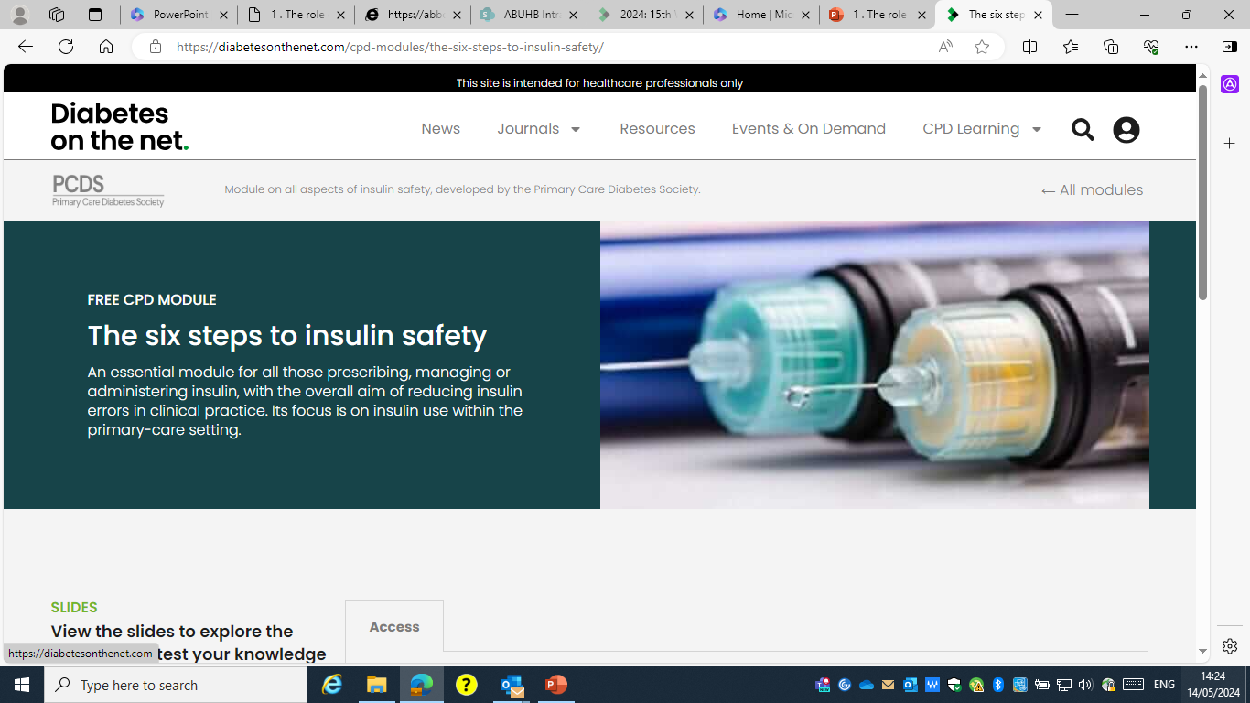

Slide 4
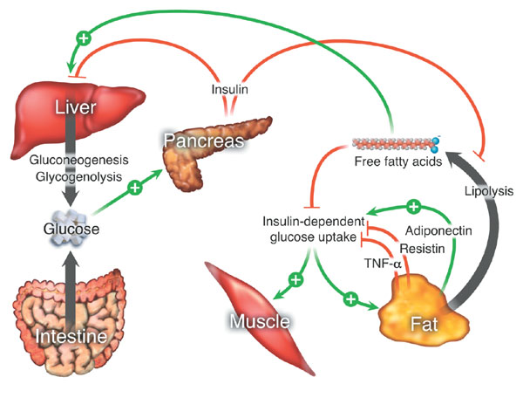
The role of Insulin
Ingestion of glucose stimulates release of insulin.
Insulin reduces blood glucose level by promoting its use by tissues above other energy sources ( fat and protein) .
Insulin also stops the breakdown of energy stores ( Adipose tissue and muscle) , that would normally increase blood glucose.

Slide 5
In the UK, HbA_{1c} is often close to 10% prior to insulin initiation
11
10
n=1790
9
n=774
8
9.8%
8.3%
Evidence suggests that even following the introduction of insulin , HbA1c target is still not achieved . This may be due to caution in intensification
DIN-LINK data was used to identify patients with type 2 diabetes issued with their first prescription of insulin between March 2002 and April 2005 in the UK. 2040 patients were identified, of which 1790 patients had an HbA1c reading before the prescription was issued and 774 patients had a second reading of HbA1c six months later.
7
HbA_{1c} (%)
6
5
4
3
2
1
0
Starting insulin
6 months post-
insulin
Smith et al. Diabetic Medicine 2006;23(Suppl 2):85.
Notes:
Unfortunately we often leave insulin initiation as a last resort with HbA1c being very high before starting
Evidence shows that we start late but are slow at intensifying treatment

Slide 6
Significant numbers of people who could benefit from insulin therapy do not get offered or take the opportunity to start insulin
Too many people using insulin suffer from…
Hypoglycaemia
Blood glucose swings
Weight gain
Complications
Insulin Therapy and the NHS Today
Notes:
We should be more proactive at starting insulin due to the benefits of glucose control
Insulin starts and intensification must be done appropriately to avoid complications , fear and issues with poor compliance

Slide 7
how can we help people use insulin in the right way to help them achieve agreed HbA1c targets without suffering the consequences of hypoglycaemia, blood glucose swings or weight gain?”
Why do we integrate Insulin Therapy into daily life?
Stay healthy
Prevention of ketoacidosis
Relieve symptoms of hyperglycaemia
Normalise lifestyle
Maintain long-term health
Prevent complications
Insulin Replacement Therapy - the challenge for healthcare professionals
Notes:
Appropriate as safe use of insulin therapy is a challenge to Health Care professionals

Slide 8
When do we consider insulin therapy?
Type 1 diabetes
Type 2 diabetes for rescue treatment or when other therapies are not appropriate?
How do we start?
How many injections?
What types of insulin(s)?
What kind of device(s)?
What size of needles?
What dose of insulin(s)?
What about orals?
How do we help people use insulin?
Self-management?
Dose titration and adjustment?
Food, activity, day-to-day life?
Illness?
Insulin Replacement Therapy
– key questions

Slide 9
NICE Guidelines
Guidelines have been published that suggest when insulin should be considered in Type 2 diabetes ( Ng28 , 2022)
Consider insulin if a person is acutely unwell and with osmotic symptoms
Consider insulin during intensification if oral therapies are not effective

Slide 10
Insulin Replacement Therapy - the decisions
Right Insulin
Right Regimen
Right Delivery System
Right Dose
Notes:
Starting insulin can be confusing
There are several important things that need to be considered

Slide 11
The onset and duration of Insulin
Rapid-acting analogue
0
4
6 12 24
Short-acting (soluble/regular)
0
4 8 12 24
Intermediate Acting (isophane / NPH)
0 8 12 18 20 22 24
Long acting analogue
0 4 24
Rapid-intermediate mixture
0 4 8 18 20 24
Short-intermediate mixture
0 4 8 18 20 24
Notes:
Often it is easier to picture the insulin profile to work what would suite the individual

Slide 12
The insulin start
Evidence has suggested it is often best to start with a basal insulin to add onto current regimen
NICE suggest that NPH insulin should be first choice
Insulatard / Insuman/Humulin I

Slide 13
Titration Regimens - the starting dose There are two alternative suggestions that can be considered:-
10units basal insulin at night
May consider a smaller dose of insulin if low BMI or other concerns/ risks
Start dose to be the lowest fasting blood glucose reading
This may be useful in those who are overweight and likely to be insulin resistant
Frailty
Reduced cognition/ understanding
Vulnerable – living alone
Other co-morbidities that may affect glucose absorption / diet

Slide 14
Titration Regimens - increasing the insulin dose
Check daily fasting blood glucose levels
Set an individualised target for this glucose level
Base insulin increase depending on three consecutive glucose readings
Normally aiming for 6-8mmol/l
Increase insulin dose by 2units or by 10% ( which ever is the larger) until target is reached
Consider setting reviews
Contact every 2-3 weeks Or
Contact when target is reached Or
Contact if target has not been reached and dose is now more than 0.3units / Kg or 0.5units / Kg of body weight

Slide 15
Rate of insulin titration
Too rapid titration / intensification may cause problems
Precipitation retinal changes
Absolute / relative hypoglycaemia
Consider a more active titration if :-
Osmotic symptoms
This implies acute loss of insulin production and more rapid control of glucose may preserve B Cell function in type 2
Ketones present
Suggest decompensation due to insulin deficiency and a more rapid correction will stop worsening of metabolic issues
Acute illness
Steroids prescribed
Consider a slower titration if:-
Hyperglycaemia present for several weeks +
Frail / elderly
Poor understanding or ability to monitor
Known Retinopathy

Slide 16
Titration Regimens - when increasing the insulin dose doesn’t appear to be working
Review should be considered if there appears to be a poor response to insulin
Revisit the basics
Storage of insulin
Injection technique
Appropriate use of device
Injection sites
Diet and lifestyle change
Influence of other therapies that may have been started or stopped
Advise blood glucose monitoring other times of the day
Consider alternative regimen before further up titration of basal insulin
Addition of bolus quick acting insulin before food
Twice daily mixed insulin
Addition of other therapies

Slide 17
Options / Alternative regimens
Meal Time Bolus insulin
Mixed Insulin
Basal Bolus regimen

Slide 18
Practicalities Storage of insulin
Insulin is a protein and must be kept in a certain state to remain active
Insulin should be kept refrigerated to maintain its’ shelf life
Insulin should NOT be frozen
It can remain at room temperature for up to 30days
If outside the fridge for more than 30days, it should be disposed of

Slide 19
Insulin Storage
Store injectables in current use at room temperature
Avoid direct sunlight , temperature extremes
Unopened devices to be stored in the refrigerator
Avoid freezing
Never leave needle on device

Slide 20
Preparation of insulin
If the insulin is cloudy , it will require suspension
Advise on ‘rock and roll’ technique

Slide 21
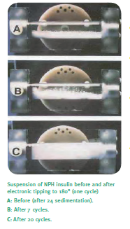
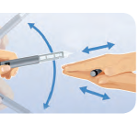
Insulin Suspension Rock & Roll

Slide 22
Correct use of the device

Slide 24
Keep injection sites healthy:-
Always inspect site prior to injection.
Avoid injecting into sites showing :-
Lipo-hypertrophy
Oedema
Inflammation
Infection
Inject only into a clean site
with clean hands
Cleanse site with domestic soap if required
Not alcohol wipes
Always rotate sites
Never reuse needles

Slide 25
Needle Length
Insulin injected into a muscle will be absorbed quickly
Increased blood glucose variability
Increased risk of hypo-glycaemia
Muscular injections tend to hurt
Longer needles increase risk of inter-muscular injections

Slide 26
Lipo-hypertrophy
Lipo-hypertrophy can take months to years to resolve
Switching to normal sites will often require a reduction in insulin dose
Caution :-
too much can lead to Hyperglycaemia / ketosis
Too little can lead to Hypoglycaemia

Slide 27
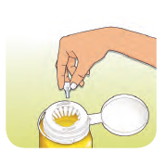
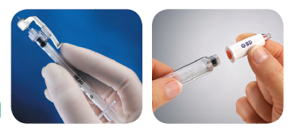
Needle Safety
Sharps bin
Needle safety devices

Slide 28
Insulin passports
Insulin passports are a means by which a person can identify what insulin they are on and acts as a safety mechanism
Identifying the person has diabetes and on insulin
So if unconscious , they can be checked for hypoglycaemia and treated
Ensuring that the correct insulin is prescribed , dispensed and administered.
Notes:
Explain about importance of insulin passports and reason behind their use – giving examples of common errors ( Humalog / Humalog mix25 ) device differences and also concern with BIOSIMILARS

Slide 29
Good understanding and safety is important
Understanding of what insulin does
Include means of identification ( Insulin Passports)
Appropriate diet and lifestyle
Include hobbies / driving/ eating out and alcohol
Knowledge of type of insulin
How to monitor glucose appropriately
Symptom dentification
Hypoglycaemia / Hyperglycaemia and their management
Sick Day Rules
Driving Advice

Slide 30
When to monitor ?
Depends on reason
Safety
Glycaemia for health ( pregnancy / ketosis risk)
Dose adjustment
Carbohydrate /insulin matching
Risk
Driving / occupation
Lifestyle
Activity / exercise
Regimen
Oral therapy / insulin type and regimen
Interpretation of results
Evidence that monitoring results in a change

Slide 31
Glucose monitoring
The monitoring of glucose should be timely and appropriate to the individual.
The type of monitoring will be influenced by patient choice but also on need and risk
People who require frequent glucose monitoring may be considered appropriate to offer non-blood testing such as CGM (Continual Glucose monitoring) or using a sensor FreeStyle Libre/Dexcom one.

Slide 32
New indication for prescribing Sensors
Health Technology Wales has published new guidance recommending flash glucose monitoring for all people with diabetes who are treated with insulin in Wales (i.e both type 1 and type 2 diabetes):
HTW Guidance:
"Based on the clinical and cost effectiveness evidence, the Appraisal Panel concluded that the evidence supports the routine adoption of FLFGM for people with diabetes (of any type) who require treatment with insulin.
- people who cannot use current forms of glucose monitoring, or for whom use may be distressing, such as those with dementia, learning disabilities or needle phobias;
- people who need extra care or assistance with glucose monitoring, such as children or the elderly;
The evidence supports the routine adoption of Freestyle Libre flash glucose monitoring to guide blood glucose regulation in people with diabetes who require treatment with insulin.
The use of Freestyle Libre flash glucose monitoring in these people improves the proportion of time that the blood glucose is in target range and reduces time in hypo and hyperglycaemia.
Health economic modelling indicates that the use of Freestyle Libre flash glucose monitoring is a cost effective intervention compared to finger-prick self monitoring of blood glucose with incremental cost effectiveness ratios (ICERs) of £4,706 and £13,137 per QALY for type 1 and type 2 diabetes, respectively.”
It was noted that there are a range of additional specific scenarios in which FLFGM may also potentially offer benefit, such as:

Slide 33
Hypoglycaemia
Classified as a blood glucose < 4mmol/l
But symptoms may be felt at higher levels depending on rate of fall of the glucose
Be aware that symptoms may ne be very clear in older ages and patients on certain medications such as B Blockers
Discuss
Likely symptoms
Management of low blood glucose

Slide 34
Some patients may be more at risk of Hypoglycaemia than others. Criteria for assessing Hypo-glycaemic risk:-
Major Criteria
Minor Criteria
History of previous Major Hypo-glycaemia
Hypo-glycaemia unawareness
Severe renal deficiency eGFR <30ml/min
Dementia or Cognitive Functional Decline
Frailty / Elderly
Previous
Hypo-glycaemia
Mild renal insufficiency eGFR <60ml/min
Duration diabetes >10yrs
Age >70yrs
Autonomic neuropathy
Low BMI <22Kg/m2
Polypharmacy
Lack diabetes education

Slide 35
The Management of Hypoglycaemia ( a Blood Glucose <4mmol/l )
If conscious and able to swallow, treat with a fast-acting carbohydrate by mouth.
If necessary, repeat treatment after 15 minutes, up to a maximum of 3 treatments in total.
Once blood-glucose concentration is above 4 mmol/litre and the patient has recovered,
Insulin should not be omitted if due, but the dose regimen may need review.
Hypoglycaemia which does not respond (blood-glucose concentration remains below 4 mmol/litre after 30–45 minutes or after 3 treatment cycles), should be treated with intramuscular glucagon or glucose 10% intravenous infusion.
Fast-acting carbohydrates include glucose liquid, glucose tablets, glucose 40% gels (e.g. Glucogel®, Dextrogel®, or Rapilose®), pure fruit juice, and sugar (sucrose) dissolved in an appropriate volume of water.
Orange juice should not be given to patients following a low-potassium diet due to chronic kidney disease
Chocolates and biscuits should be avoided if possible, as they have a lower sugar content and their high fat content may delay stomach emptying.
a snack providing a long-acting carbohydrate should be given to prevent blood glucose from falling again (e.g. two biscuits, one slice of bread, 200–300 mL of milk (not soya or other forms of 'alternative' milk, e.g. almond or coconut), or a normal carbohydrate-containing meal if due).

Slide 36
Hyperglycaemia
Discuss
what levels may cause concern
Reasons for elevation
Reduced insulin availability ( Missed dose / poor injection/storage insulin)
Lack of activity
Food ingestion
Illness
Management
Insulin dose change / fluids / when to seek advice
The need if appropriate for ketone testing

Slide 37
Sick Day Rules
What is meant by “ Sick Day Rules” ?

Slide 38
S.I.C.K.
S (Sugar)
Blood glucose levels can rise during illness even if the person is not eating
Advise to increase blood glucose monitoring if the person has access to it
Diabetes medications (sulfonylureas and insulin doses) may need to be increased temporarily during illness to manage these raised glucose levels
I (Insulin)
NEVER stop insulin
Insulin doses may need to be increased during illness, especially if ketones are present
C (Carbohydrate)
Ensure the person maintains hydration and carbohydrate intake
If the person is not able to eat or is vomiting, advise to replace meals with sugary fluids
If blood glucose levels are high, maintain fluid intake with sugar-free fluids
If blood glucose levels are low, encourage regular intake of sugary fluids
K (Ketones)
In type 1 diabetes, advise to check for ketones every 2–4 hours ( also patients on SGLT2 therapies)
Give extra rapid-acting insulin doses (in addition to regular doses) based on total daily
insulin dose needs alteration if ketones are present –
Advise to drink plenty of water to maintain hydration and flush through ketones

Slide 39
Insulin management at times of illness

Slide 40
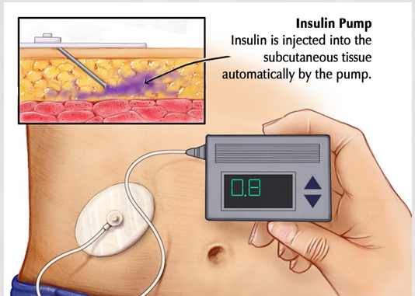
Insulin Pump Therapy
An insulin pump is a battery-operated device that provides regular insulin throughout the day.
The insulin is provided via a cannula, inserted under the skin. This can be left in for two to three days before it needs to be replaced and moved to a different insulin injection site.
When eating, extra insulin can be given using the pump. ('bolus dose‘).
The specialist nurse and dietitian will help work out how much insulin is needed

Slide 41
Prescribing for pump users
Rapid acting insulin for pump
Adequate number of BGM test strips to allow for ( normally minimum 200/month)
Pre and post prandial blood glucose
Nocturnal blood glucose
Exercise testing
Sick day rules
Ketone test strips ( ideally for blood)
Emergency pack
Glucagon
Spare basal and rapid insulin via pens in case of pump failure
Pen needles
Continuous Glucose Monitoring (Sensors)

Slide 42
Prescribing for Pump patients
Vials
Monitoring equipment
Glucose testing
Ketone testing
Spare insulin pens
And insulin in case of pump failure
Remember both bolus insulin and basal insulin will be needed
Pen needles
Barrels or carts

Slide 43
GAPP – patient-cited issues with insulin treatment
Insulin-treated diabetes controls their life
Insulin regimen can be restrictive
Hard to live normal lives whilst managing diabetes
Wish insulin regimen would fit daily life changes
Number of daily injections
Taking insulin at prescribed time/meals everyday
Percentage
GAPP, Global Attitudes of Patients and Physicians
Global cohort n=1530
Peyrot et al. Diabetic Med 2012;29:682–9
Notes:
Insulin is not without its challenges
These include
Injection
Device
Fear
Short term and long term complications / risks
Psychological issues
Social issues

Slide 44
Insulin Doses Are Being Missed Or Not Taken As Prescribed
Too busy
18.9%
Travelling
16.2%
27%
33%
67%
73%
Challenging to take at same time each day
9.4%
Forgot
7.4%
33% of patients sometimes miss their insulin dose, or fail to take as prescribed, up to 3.3 doses in the last month
73% of physicians estimate that their patients would have missed as many as 5.7 doses per month
Regimen too complicated
3.8%
Peyrot et al. Diabetic Med 2012;29:682–9
Notes:
Compliance can be a significant issue

Slide 45
Frail elderly or End of Life Reducing / stopping insulin
Due to change in circumstance , regimens may need review and be changed.
Insulin may need to be reduced , altered or even stopped
Consider what may issues may cause a need for change

Slide 46
Consider in which scenario would you consider human vs analogue basal insulin
Elderly
Pregnancy
Living alone
Type1 / Type 2
Pancreatic exocrine insufficiency
Occupation
Steroid use
End of life
Confusion
Frailty
Dexterity
Dietary regimen
Glucose monitoring
Attainment of targets
Glycaemic risk
Notes:
Looking at these patient types , in what circumstances would each of these profiles may be better suited ?
Consider
Food compliance
Injection compliance ( Self / DN administered)
Avoidance of other therapies ( Bolus insulin)
Hypoglycaemia risk
Target attainment
Need for monitoring

Slide 47
Poor control despite reasonable dose of insulin
Consider
Compliance issues
Insulin issues
Equipment issues
Injection sites
Insulin type/ dose
Insulin resistance
Other therapies affecting control
Diet
lifestyle
insulin administration
Dosing
Timing

Slide 48
Poor control despite reasonable dose of insulin
Consider
Compliance issues
Insulin issues
Equipment issues
Injection sites
Insulin type/ dose
Insulin resistance
Other therapies affecting control
Correct insulin being dispensed
Insulin in date
Insulin being stored appropriately

Slide 49
Poor control despite reasonable dose of insulin
Consider
Compliance issues
Insulin issues
Equipment issues
Injection sites
Insulin type/ dose
Insulin resistance
Other therapies affecting control
Needles
Correct size /type
Regular change
Both caps removed
Correctly put on pen ( Not bent) – always advise on air shot
Device
Correct use of device
Dialling correct dose
Pressing plunger to administer insulin
Correct device for insulin
Cartridge being changed, if appropriate
Cartridge / pen not damaged
Pen ( if not disposable ) no more than 2 years old

Slide 50
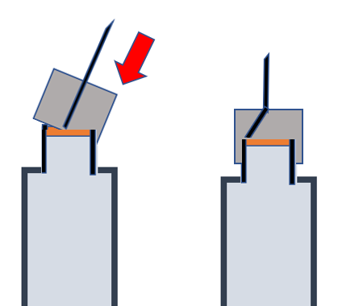
Poor control despite reasonable dose of insulin
Consider
Compliance issues
Insulin issues
Equipment issues
Injection sites
Insulin type/ dose
Insulin resistance
Other therapies affecting control
Needles
Correct size /type
Regular change
Both caps removed
Correctly put on pen ( Not bent) – always advise on air shot
Device
Correct use of device
Dialling correct dose
Pressing plunger to administer insulin
Correct device for insulin
Cartridge being changed, if appropriate
Cartridge / pen not damaged
Pen ( if not disposable ) no more than 2 years old

Slide 51
Poor control despite reasonable dose of insulin
Consider
Compliance issues
Insulin issues
Equipment issues
Injection sites
Insulin type/ dose
Insulin resistance
Other therapies affecting control
Needles
Correct size /type
Regular change
Both caps removed
Correctly put on pen ( Not bent) – always advise on air shot
Device
Correct use of device
Dialling correct dose
Pressing plunger to administer insulin
Correct device for insulin
Cartridge being changed, if appropriate
Cartridge / pen not damaged
Pen ( if not disposable ) no more than 2 years old

Slide 52
Poor control despite reasonable dose of insulin
Consider
Compliance issues
Insulin issues
Equipment issues
Injection sites
Insulin type/ dose
Insulin resistance
Other therapies affecting control
Appropriate sites
Site rotation
Health of injection areas
Trauma
Lipodystrophy

Slide 53
Poor control despite reasonable dose of insulin
Consider
Compliance issues
Insulin issues
Equipment issues
Injection sites
Insulin type/ dose
Insulin resistance
Other therapies affecting control
Over treatment
causing silent hypoglycaemia and rebound
Glucose profiles
Fasting vs Post prandial control

Slide 54
Poor control despite reasonable dose of insulin
Consider
Compliance issues
Insulin issues
Equipment issues
Injection sites
Insulin type/ dose
Insulin resistance
Other therapies affecting control
Metabolic syndrome
Hypothyroid
Endocrinopathies

Slide 55
Poor control despite reasonable dose of insulin
Consider
Compliance issues
Insulin issues
Equipment issues
Injection sites
Insulin type/ dose
Insulin resistance
Other therapies affecting control / other illnesses
Steroids
Oral hypoglycaemic agents
Illnesses causing stress
PEI
Gastroparesis
Illnesses affecting digestion
Physical
Emotional

Slide 56
When starting Insulin therapy in Adults with type 2 diabetes use a structured education programme
The programme should include:-
Storage of insulin
Correct use of device
Injection technique
Including rotating sites and avoiding repeated injections at the same point within sites
Sharps disposal
Continuing telephone support
Self monitoring
Dose titration to target levels
Dietary understanding
DVLA guidance
Management of Hypoglycaemia
Management of acute changes in plasma glucose control
Support from an appropriately trained and experienced health care professional
Insulin use
Review
Education
Baseline assessment tool for Type 2 diabetes: management (NICE clinical guideline NG28)
Notes:
3 specific sections that that need to be covered
Options regarding insulin delivery systems – which one will best suit the physiology, psychology and sociology of each patient?
This section should be discussed when reviewing insulin use as well as at initiations

Slide 57
When starting Insulin therapy in Adults with type 2 diabetes use a structured education programme
The programme should include:-
Storage of insulin
Correct use of device
Injection technique
Including rotating sites and avoiding repeated injections at the same point within sites
Sharps disposal
Continuing telephone support
Self monitoring
Dose titration to target levels
Dietary understanding
DVLA guidance
Management of Hypoglycaemia
Management of acute changes in plasma glucose control
Support from an appropriately trained and experienced health care professional
Review
Education
Baseline assessment tool for Type 2 diabetes: management (NICE clinical guideline NG28)
Notes:
The review identifies the support that should be offered

Slide 58
When starting Insulin therapy in Adults with type 2 diabetes use a structured education programme
The programme should include:-
Storage of insulin
Correct use of device
Injection technique
Including rotating sites and avoiding repeated injections at the same point within sites
Sharps disposal
Continuing telephone support
Self monitoring
Dose titration to target levels
Dietary understanding
DVLA guidance
Management of Hypoglycaemia
Management of acute changes in plasma glucose control
Support from an appropriately trained and experienced health care professional
Education
Baseline assessment tool for Type 2 diabetes: management (NICE clinical guideline NG28)
Notes:
Education to ensure understanding of insulin use / safety and self management of possible issues

Slide 59
Summary
Living with insulin is different for each patient, a complex mix of their physical and social characteristics
Different insulins, regimens and methods of delivery allow tailoring to an individual needs
Education and effective use of SMBG are crucial to successful use of insulin therapy
Balance needs to be struck between HbA1c target and risk of hypoglycaemia and weight gain

